Slide 1
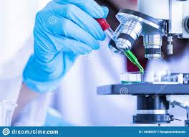
METHODS OF STUDYING CELLS

Slide 2
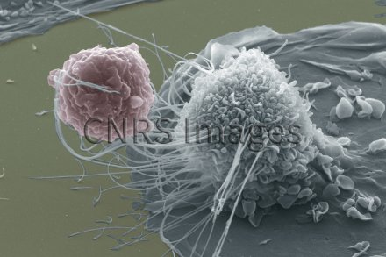
Lesson plan
1- Introduction
2- Microscopy techniques
3- Types of microscope
A- Light microscope
B- Electron microscope

Slide 3
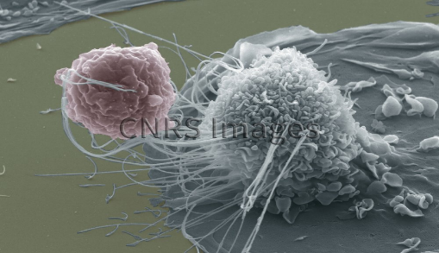
I-Introduction
The progress of medicine remains dependent on the combined use of several varied methods and techniques.
These techniques allow us to understand the structure and function of several types of cells.
The progress of medicine is based largely on advances in cellular and molecular biology
Several techniques have been developed to study cell structure and function. Among these techniques:

Slide 4
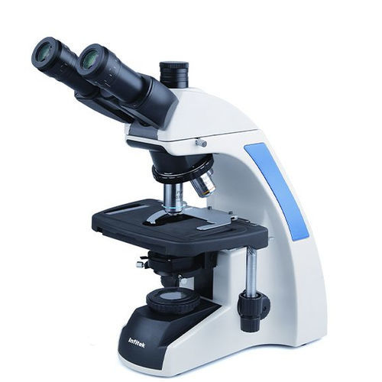
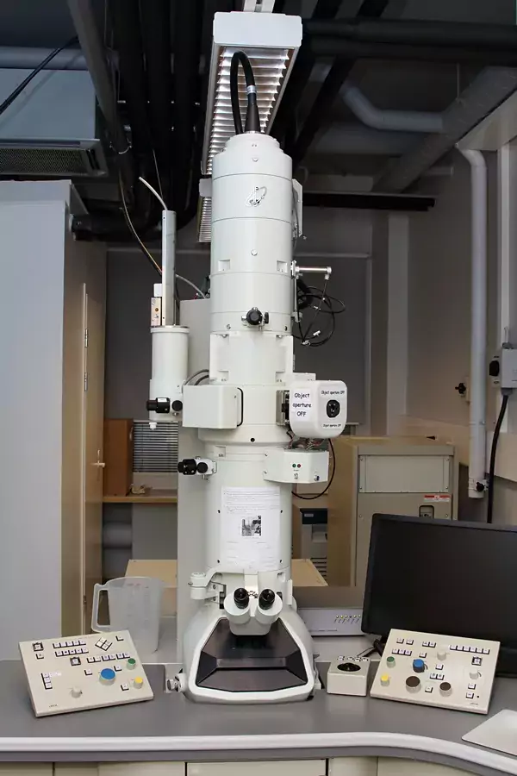
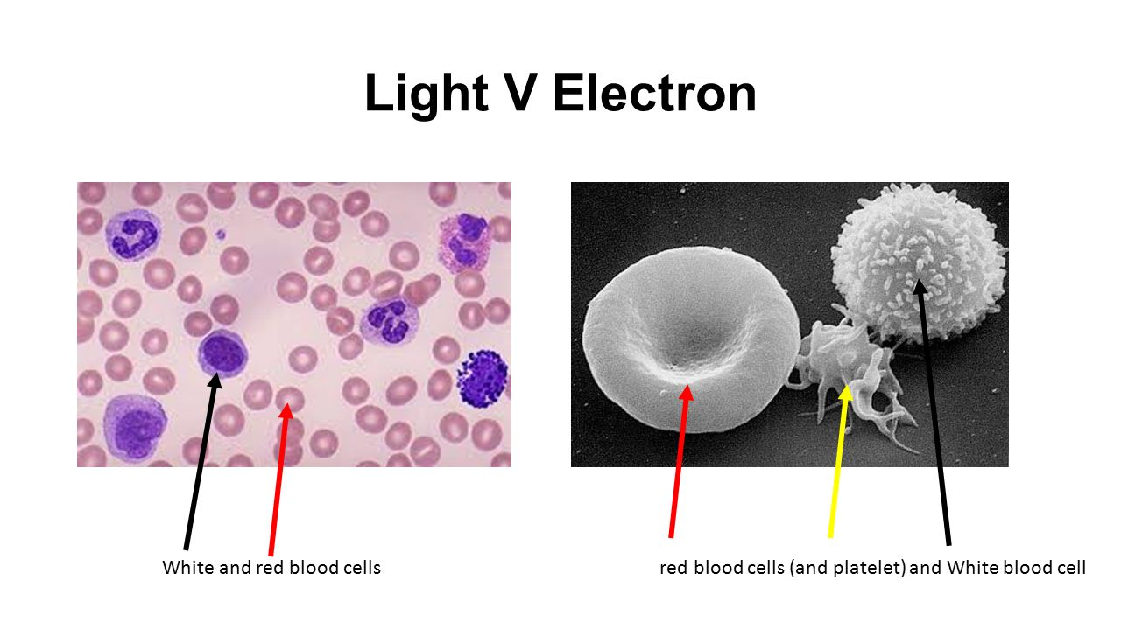
1. Microscopy
Observation of Cellular shapes and Structures
Light Mic
Electron Mic

Slide 5

II. Microscopy techniques
A- Definition
Is a set of techniques for imaging small objects.
Microscopy allows us to see extremely tiny structures, such as eukaryotic and prokaryotic cells, viruses, and even proteins and DNA.
In cytology, microscopy is a technique for observing cellular constituents
The tool used to make this observation possible is called the microscope

Slide 6
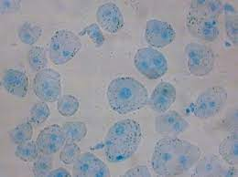
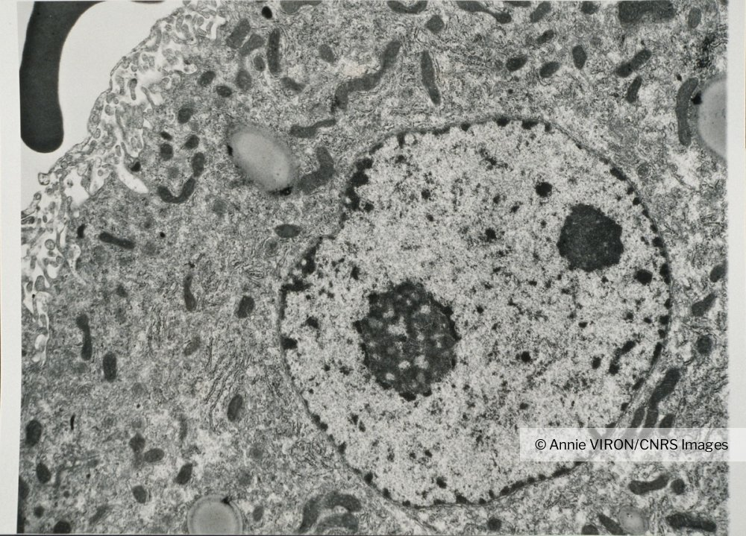
B- Types of microscope
Electronic M
Light M

Slide 7
A- Types of light microscopes
There are several types of light microscopes.
1. Bright-field microscope (transmission)
2. Dark field Microscope
3. Phase contrast M.
4. Fluorescence M
And others…….

Slide 8
1. Light microscope
a. Bright-field microscope (transmission)
The bright field microscope uses visible light (lamp) as a light source.
It is equipped with three transparent glass lens systems:
A condenser: used to concentrate the light on the sample.
An objective: performs the primary magnification.
An eyepiece: performs secondary magnification of the image provided by the objective.

Slide 9

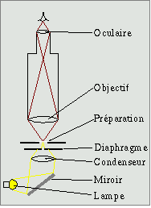
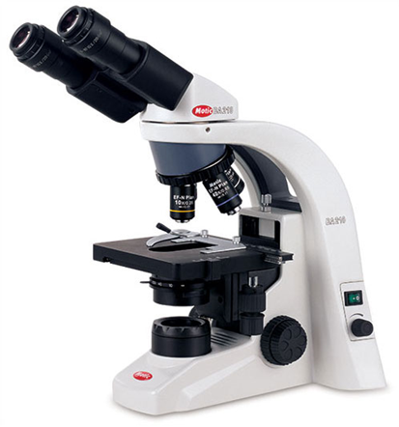
a. Bright-field microscope (transmission)
Trajet lumineux
Résolution (0,2 μm)
Eyepiece (ocular)
Objective
Sample
diaphragm
Condenser
Light source

Slide 10
a. Bright-field microscope (transmission)
It is used routinely in biology and medical laboratories
The samples studied are pre-treated with dyes (contrast)
In the case of tissues, the samples must be finely cut (very thin sections),
It forms, a dark image on a light background.

Slide 11
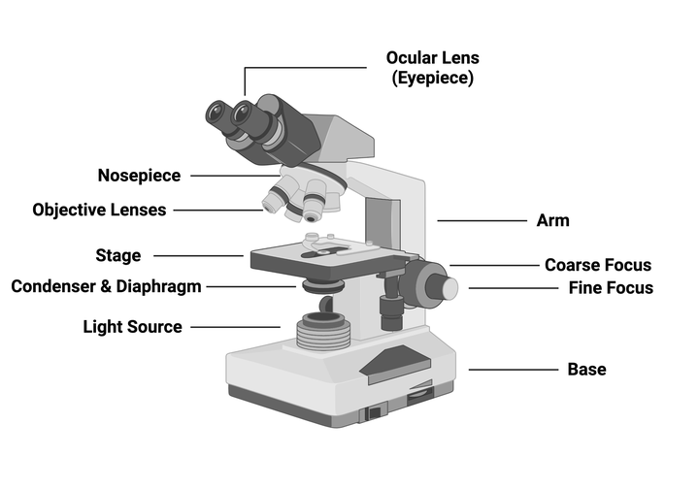
Parts of light microscope

Slide 12
Resolving power (Resolution)
Resolving power, or Resolution, refers to the minimum distance separating two distinguishable points (Resolution limit)
The conventional light microscope is about 0.2 μm and the magnification can reach up to 2000 times.

Slide 13
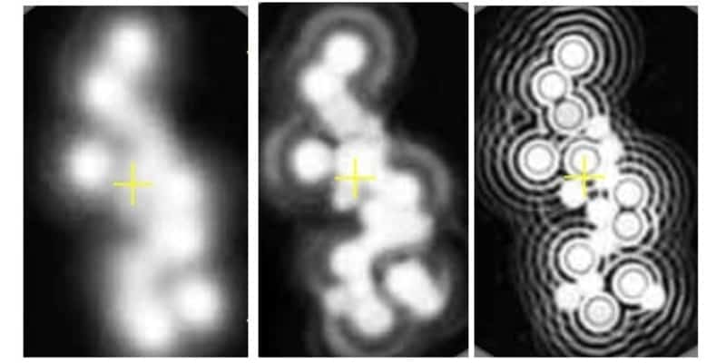
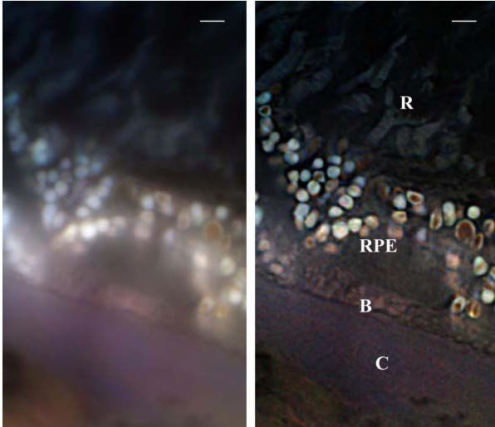

Slide 14
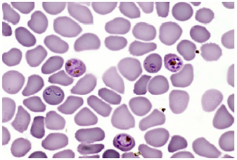
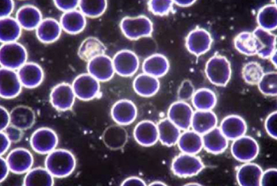
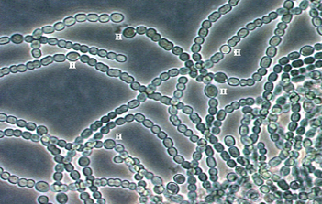
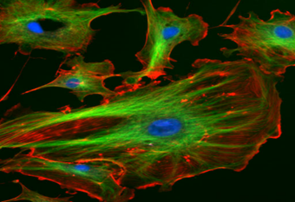
Types of Light microscopes
(A) Blood sample ( B.F.M).
(B) Blood sample (D.F.M).
(C) Cyanobacteria (Phase contrast M)
(D) Endothelial cells (flueorescence M)

Slide 15
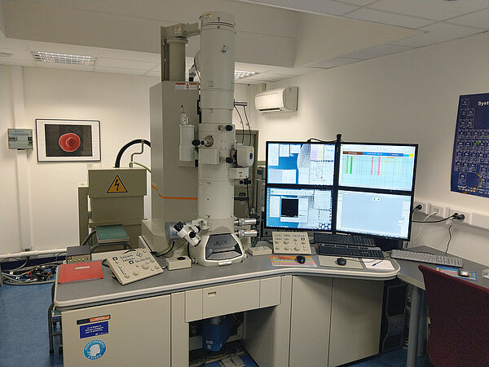
2. Electron microscope

Slide 16
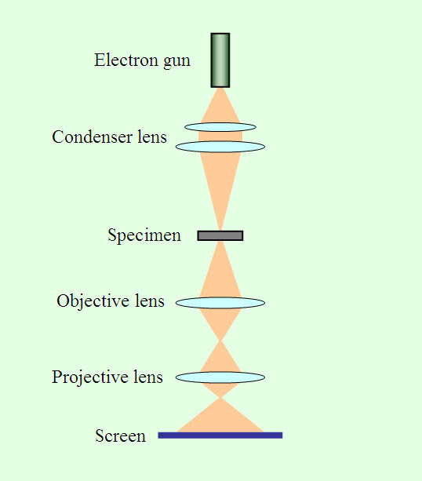
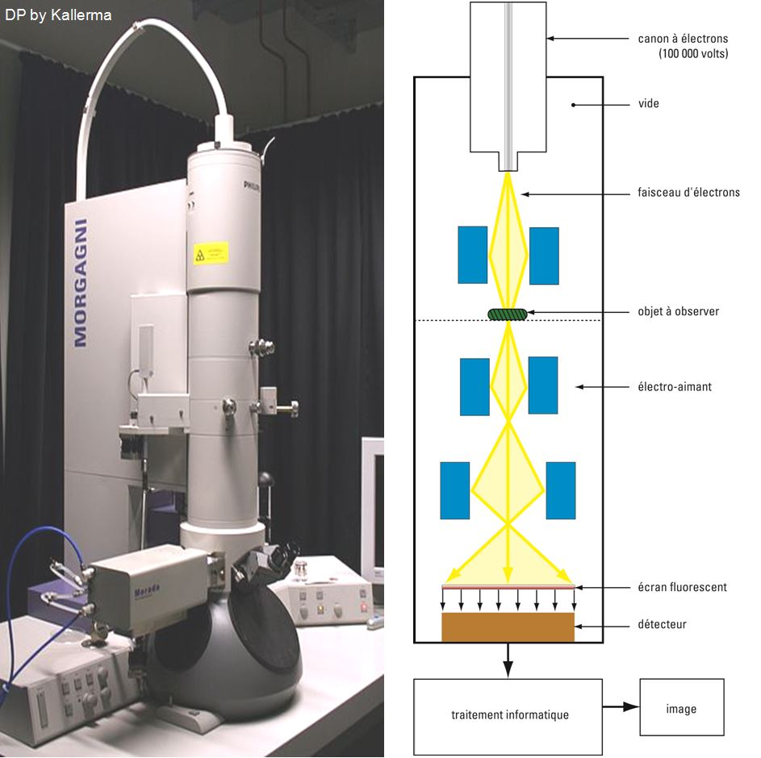
2. Transmission Electron Microscope (TEM)
Grossissement 2000000 fois, Résolution 0.05 nm

Slide 17
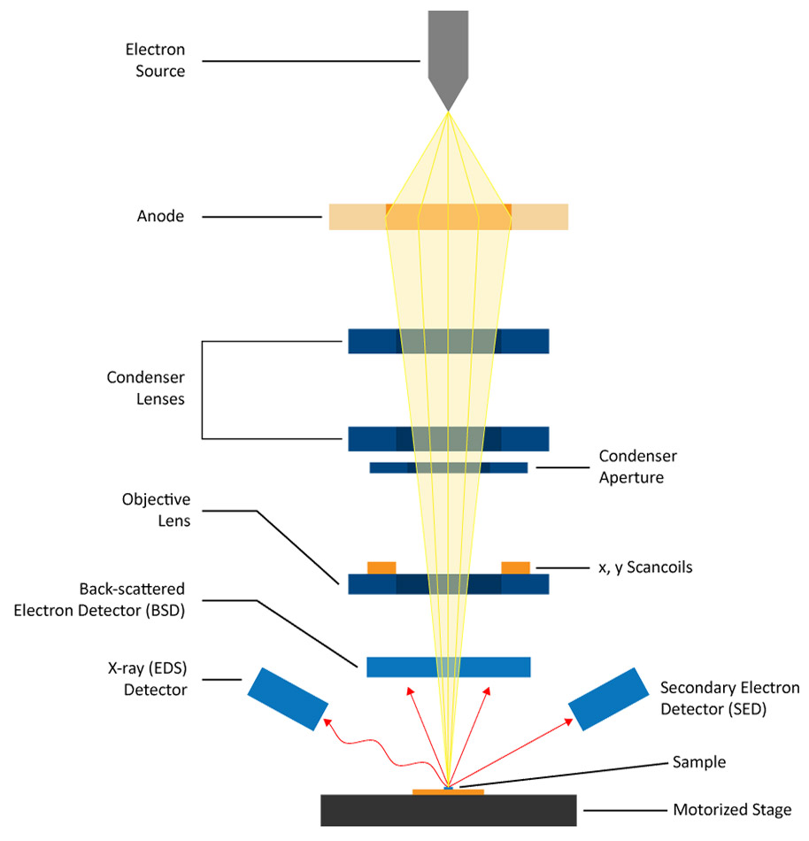
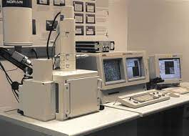
2. Scanning Electron Microscope (SEM)

Slide 18
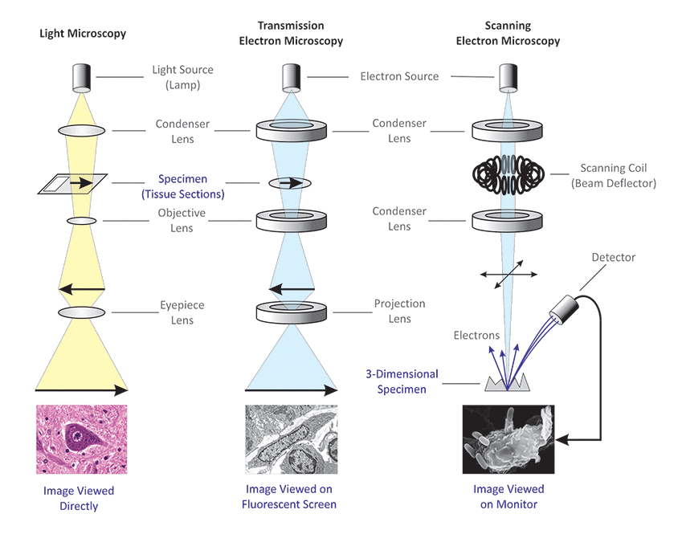

Slide 19
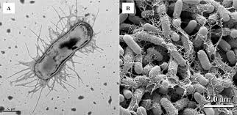
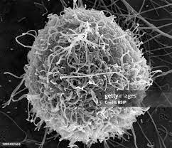
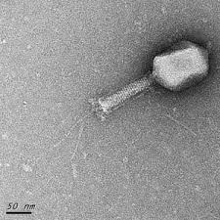

Slide 20
